Slide 1
Increase Productivity in Microsoft Teams with JAWS
Presented by
Rachel Buchanan, Director, User Education & Technical Support
Elizabeth Whitaker, Manager of User Education & Outreach

Slide 2
Teams Overview
Teams is a communication application used in schools and organizations.
Engage in chats, make calls, and schedule meetings in one place.
Feature availability can vary from one organization to another, depending on the organization’s needs.

Slide 3
Navigate the Teams Interface with JAWS
Navigate the Teams desktop app using Windows and Teams-specific keyboard commands.
Toggle off the JAWS Virtual PC Cursor to navigate in Teams as you would in other desktop apps.
At times, you may need to turn on the PC Cursor to navigate the Teams interface as you would a web page.
Press INSERT+Z to toggle the Virtual PC Cursor on and off.
Press CTRL+F6 to navigate to different screen elements in Teams.
Navigate among views such as Activity, Chat, Teams, Calendar, Calls, and Files using the keyboard.
Press CTRL plus the corresponding number on the number row to navigate to each view, such as CTRL+1 for Activity or CTRL+2 for Chat.

Slide 4
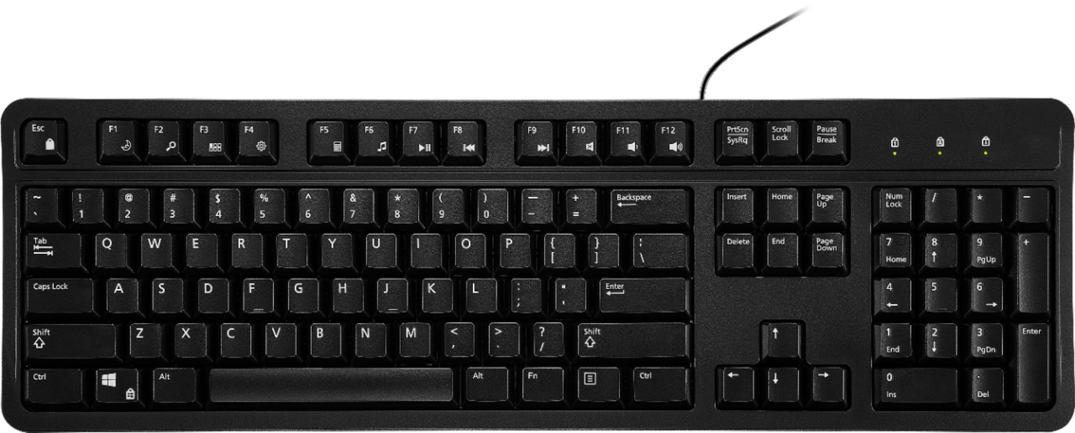
New Keyboard Model
Use keyboard commands to quickly navigate within sections of Teams, such as chat, activity feed, teams, and channels.
Press CTRL+PERIOD to get help.

Slide 5
Access and Navigate Chats
Navigate the list of chats with the UP ARROW and DOWN ARROW keys.
Press the SPACEBAR to enter a chat.
Navigate messages using the UP ARROW and DOWN ARROW keys.
Focus goes to the oldest unread message so you can work forward.
Press ESC or CTRL+L to return to the chat list.
Press ENTER on a chat to place the focus in the Compose box.
Press ESC to return to the list of chats when in the Compose box.

Slide 6
Navigate Chats Demo

Slide 7
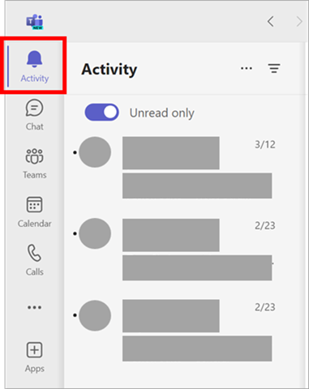
Access and Navigate the Activity Feed
Navigate the activity feed using the UP ARROW and DOWN ARROW keys.
Press the SPACEBAR to enter an activity in the feed.
Press ESC or CTRL+L to return to the activity list.

Slide 8
Navigate the Activity Feed Demo

Slide 9
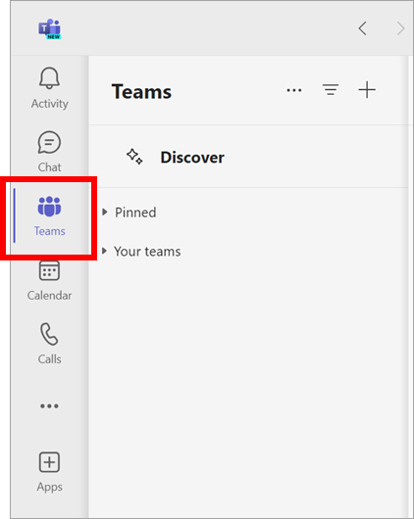
Access and Navigate Teams and Channels
Navigate teams and channels the same as chat and activity feed.
Press the SPACEBAR to expand a team or channel.
Press ENTER to open posts and items within posts.

Slide 10
Navigate Teams and Channels Demo

Slide 11
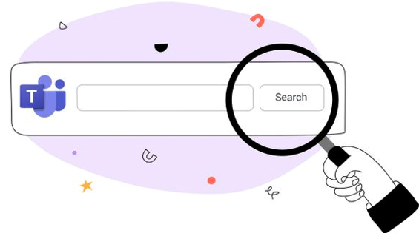
Access Help and Search
Press CTRL+PERIOD to display a list of help items.
Help items include how to search, open settings, and locate commands.
Press INSERT+W to display a list of commands.
Press CTRL+E to search for people, messages, files, and commands.

Slide 12
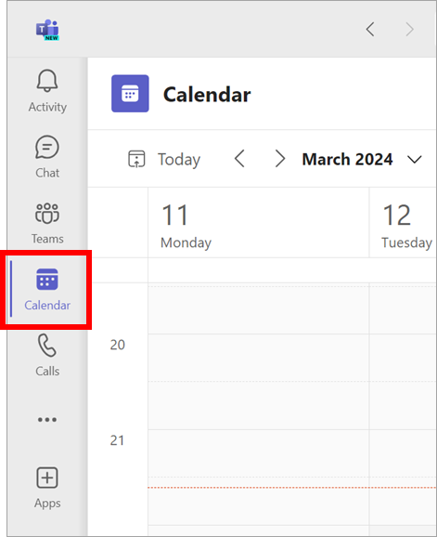
Navigate the Calendar
Press CTRL+4 on the number row to access the calendar.
Press ALT+SHIFT+N to schedule a new meeting.
Press the TAB key to navigate appointments.
Press the arrow keys to navigate by day or week.

Slide 13
Access and Share Files
Press CTRL+6 to access files.
Press the TAB key to navigate the dialog.
Set Teams to open Word, Excel, and PowerPoint files in the desktop applications.
Open files from Teams to ensure changes are visible to everyone.

Slide 14
Make a PowerPoint Presentation Accessible During a Teams Meeting
Select the PowerPoint presentation from the Share Screen dialog box rather than opening it first and sharing the application window.
Select “Private View,” then select “Allow Participants to Move Through Shared Presentation on Their Own.”

Slide 15
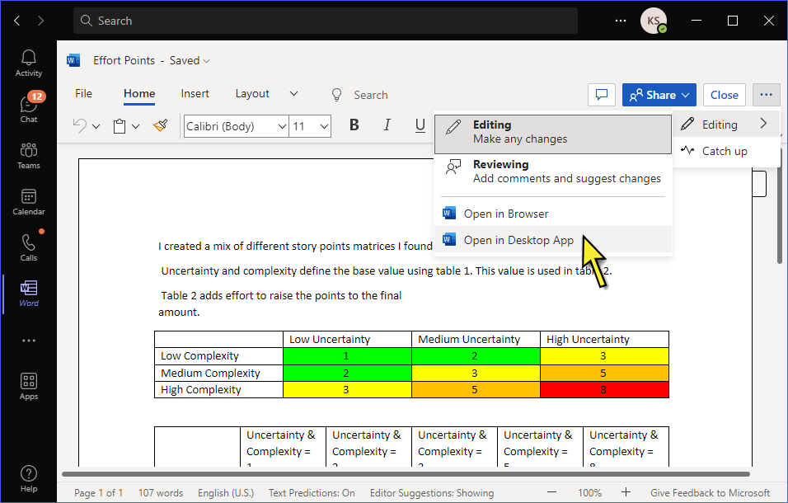
Collaborate on Files in Teams
Navigate to the file and open it in the desktop app rather than downloading it first.
This allows users to collaborate on a file.
All work is automatically saved for all users.

Slide 16
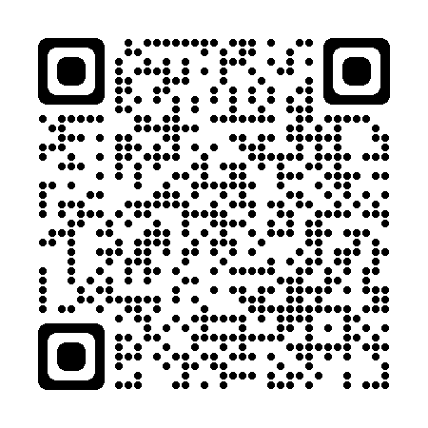
Resources
Visit the Freedom Scientific Resources page for Teams and JAWS training resources.
https://www.freedomscientific.com/resources

