Slide 1
Fusion: The Ultimate Accessibility Tool
Rachel Buchanan
Director – User Education and Technical Support – Vispero
Elizabeth Whitaker
Product Manager – User Education and Outreach – Vispero

Slide 2
ZoomText, JAWS, and Fusion
What are they?
Who are they designed for?

Slide 3
What is ZoomText?
ZoomText Magnifier/Reader is screen magnification software for Windows that allows the user to:
Magnify the screen
Change screen colors
Customize items like the mouse pointer and text cursor to make them easy to find and track on the screen.
ZoomText Magnifier/Reader has basic speech features for reading documents, web pages, and email.

Slide 4
Who is ZoomText for?
ZoomText is for any user with enough vision to see a computer screen and who may require extra visual enhancements to more comfortably read and access screen content.

Slide 5
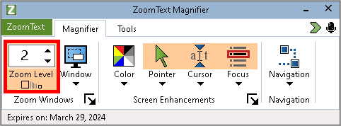
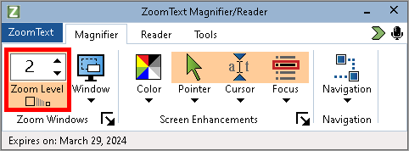
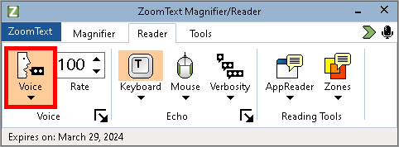
Available Versions
ZoomText Magnifier – Magnification enhancements only, no speech
ZoomText Magnifier/Reader – Magnification enhancements and basic speech

Slide 6
What is JAWS?
JAWS, Job Access With Speech, is a screen reader that provides access to the Microsoft Windows operating system.
Information is spoken aloud as it appears and changes on the computer screen.

Slide 7
Who is JAWS for?
JAWS is for any computer user whose vision loss prevents them from seeing screen content or navigating with a mouse.

Slide 8
What is Fusion?
Fusion provides the features and benefits of having both ZoomText Magnifier/Reader and JAWS screen reader in one package.
The two applications can be used together or separately to suit individual user preferences.

Slide 9
Who is Fusion for?
Fusion is perfect for individuals who, over time, want a smooth transition from using magnification to a full screen reader.
It also benefits users with advanced or progressive vision loss who can take advantage of magnification and full screen reading at the same time.
Fusion meets the needs of organizations seeking to provide tools for every level of visual impairment with a single license and installer.

Slide 10
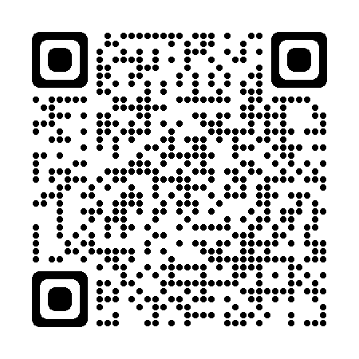
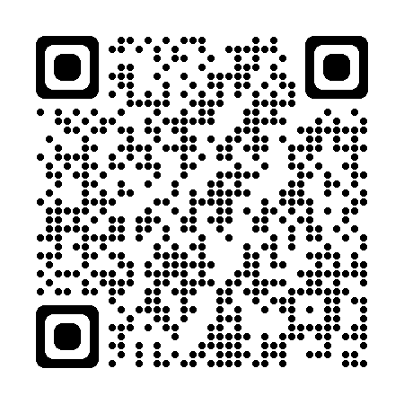
Training Resources
For training on Freedom Scientific products, visit: https://www.freedomscientific.com/training/
For Freedom Scientific training resources, visit: https://www.freedomscientific.com/resources/

Slide 11
Thank you
Thank you for joining us to learn about JAWS, ZoomText, and Fusion 2023.
Send questions or feedback to training@vispero.com.

