Slide 1
Collaboration and Productivity: Microsoft Teams and JAWS

Slide 2
Navigate the Teams Interface with JAWS
Navigate the Teams desktop app using Windows and Teams-specific keyboard commands.
Toggle the JAWS Virtual PC Cursor off to navigate in Teams as you would other desktop apps.
There may be times when you need turn it on to navigate the Teams interface as you would a web page.
Press INSERT+Z to toggle the Virtual PC Cursor on and off.
Press CTRL+F6 to navigate to different screen elements in Teams.
Navigate among views such as Activity, Chat, Teams, Calendar, Calls, and Files using the keyboard.
Press CTRL plus the corresponding number on the number row to navigate to each view, for example, CTRL+1 for Activity, CTRL+2 for Chat, etc.

Slide 3
Access a List of Keyboard Commands
Press CTRL+PERIOD to access a list of Teams-specific commands.
JAWS users must toggle the Virtual PC Cursor on to read this list – INSERT+Z.
Alternatively, press INSERT+W to access these same commands.
They will display in the JAWS Virtual Viewer, so toggling on the Virtual PC Cursor is not necessary.

Slide 4
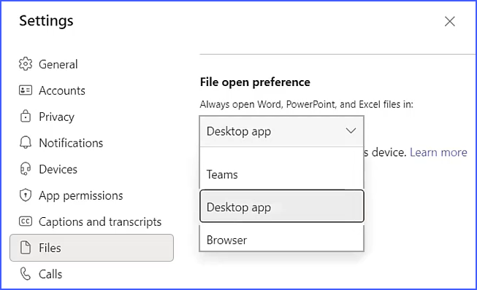
Open Word, PowerPoint, and Excel Files in the Desktop Apps
By default, pressing ENTER on a file in Teams opens it in the Teams File Viewer.
Screen reader users are unable to read a file in this viewer.
Teams provides a setting for always opening files in the desktop applications.

Slide 5
Make a PowerPoint Presentation Accessible During a Teams Meeting
Select the PowerPoint presentation from the share screen dialog rather than opening it first and sharing the application window.
Select “Private View,” then select “Allow Participants to Move Through Shared Presentation on Their Own.”

Slide 6
Make Meetings Inclusive for All
Announce your name in a meeting so JAWS users know who is talking.
Provide information about chats taking place during the meeting so JAWS users can copy it after the meeting.
JAWS users must toggle the Virtual PC Cursor on to copy the chat.
Navigate to the meeting chat and press INSERT+Z to toggle the Virtual PC Cursor on.
Each message is listed under headings.
Select the content.
Copy the text and paste it in the desired location.

Slide 7
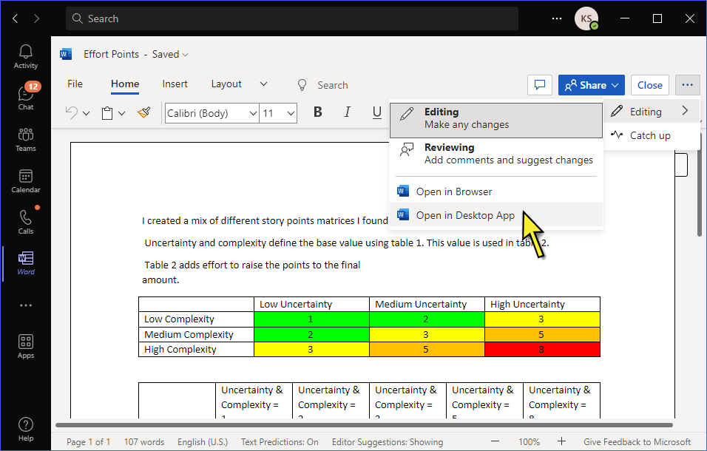
Collaborate on Files in Teams
Navigate to the file and open it in the desktop app rather than downloading it first.
This allows users to collaborate with one another on a specific file.
All work is automatically saved for all users.

Slide 8
Resources
Visit the Freedom Scientific Resources page for Teams and JAWS training resources.
https://www.freedomscientific.com/resources

