Slide 1
Collaboration and Productivity: Google Drive and JAWS

Slide 2
What We’ll Cover
Overview of Google Drive
Access the Navigation panel
Open a folder, subfolder, or file
Save a file
Upload and download files
Sort files
Search for files
Use keyboard shortcuts
Use Google Backup and Sync
Share folders and files

Slide 3
Why Google Drive
Google Drive is Google’s cloud storage and file sharing platform
It integrates with Docs, Slides, and Sheets to enable real-time collaboration
Access Google apps quickly from Drive
Requires a Google account
Accounts include 15 GB of free storage
Purchase additional storage or upgrade to Google One for added benefits

Slide 4
Access the Navigation Panel
The Navigation Panel contains views and folders in Google Drive
Press G then N to go to the Navigation Panel
Press UP ARROW or DOWN ARROW to navigate through this panel

Slide 5
Open a Folder, Subfolder, or File
Press ENTER to open a folder, file or view
Press RIGHT ARROW to open a subfolder

Slide 6
Save a File
Documents created in a Google Workspace application save automatically
Rename a Google document to match its content
Documents that are not renamed are listed as untitled
Save files to specific folders to organize them
Save files that have been shared in Google Drive

Slide 7
Upload and Download Files
Upload files from your computer to share or for backup
Download files from Google Drive to your computer
View Google documents in desktop applications like Office 365

Slide 8
Sort Files
Sort files to locate them quickly
Sort by options such as file name and last modified

Slide 9
Search for Files
Press SLASH (/) to access the search box
Type search terms and press ENTER
Focus moves to the search results
Use the advanced search feature to refine your results

Slide 10
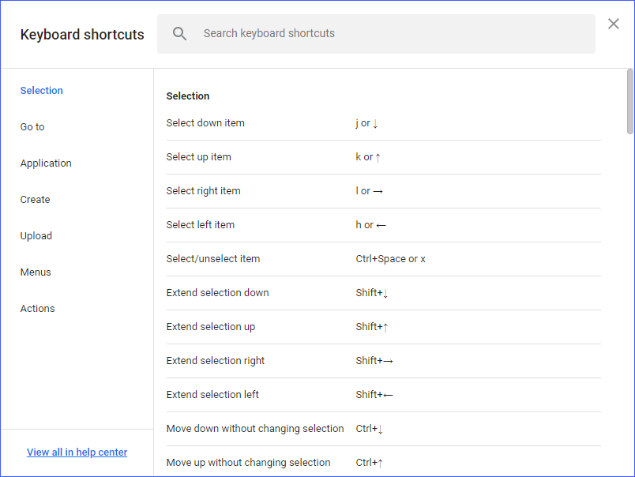
Use Keyboard Shortcuts
Use keyboard shortcuts to perform tasks
Press CTRL+SLASH to access a list of available shortcuts

Slide 11
Share Folders and Files
Share folders and files with others
Users can organize folders, plus edit and add files
Set permissions for users
If view-only, can access folders and open files
If signed in, can move, delete, and edit files

Slide 12
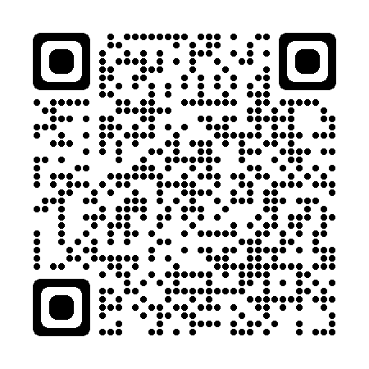
Resources
Visit the Freedom Scientific Resources page for Google Drive resources.
https://www.freedomscientific.com/resources

